Slide 1
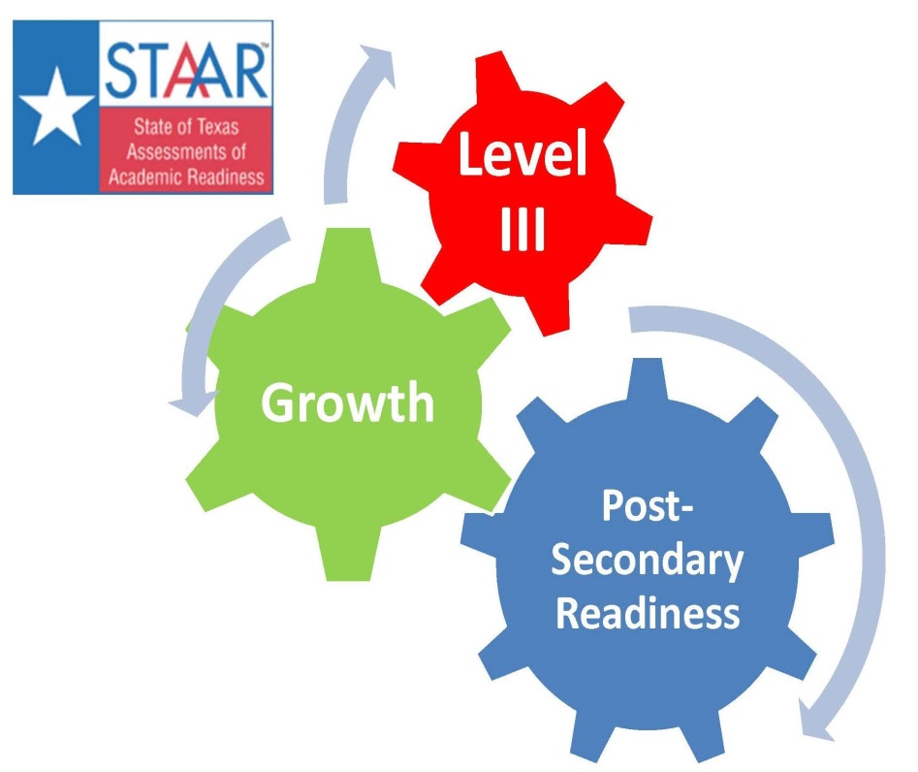
Accountability Update
Ty Duncan
tduncan@esc17.net
@instructionalle

Slide 2
2013 Statewide Results
Districts (Including Charter Operators)
Of the 1,228 districts in the state, 1,136 (92.5%) achieved a Met Standard or Met Alternative Standard rating.
A total of 80 (6.5%) districts were rated Improvement Required and 12 (1%) were labeled as Not Rated.

Slide 3
2013 Statewide Results
Campuses
Of the 8,555 campuses in the state, 7,206 (84.2%) achieved a Met Standard or Met Alternative Standard rating.
778 (9.1%) were labeled Improvement Required.
571 (6.7%) were labeled as Not Rated.

Slide 4
2013 Statewide Results
Distinction Designations
Only campuses that received a Met Standard rating are eligible for Distinction Designations in 2013. Districts, charter operators, and AEA campuses are not eligible to receive Distinction Designations.
Of the 8,555 campuses, 1,991 (23.3%) campuses received a distinction for achieving the Top 25% in Student Progress.
2,323 (27.2%) received a distinction for reading/ELA and 1,906 (22.3%) received a distinction for mathematics.
In total, 3,599 (42.1%) received one or more Distinction Designations.
759 (8.9%) received Distinction Designations in all three categories.

Slide 5
2013 Statewide Results
System Safeguards
Of the 55 performance indicators (five subject areas x 11 student groups) evaluated in the system safeguards, 52 (94.5%) indicators achieved the performance target of 50%.
All 22 of the participation indicators (two subject areas x 11 student groups) achieved the participation target of 95%.
Of the 11 student groups, 9 (81.8%) achieved the graduation rate of 78% for the four-year rate, achieved 83% for the five-year rate, or demonstrated sufficient improvement to achieve the goal of 90%.
The state did not exceed the federal limit of 1% on STAAR Alternate or the 2% limit on STAAR Modified results.

Slide 6
Phase-in Level - Met Satisfactory
Subject |  | Phase 1 | Phase 2 | Final
Reading | Grade 3 | 50% | 65% | 75%
 | Grade 4 | 55% | 66% | 77%
 | Grade 5 | 57% | 67% | 78%
 | Grade 6 | 56% | 67% | 77%
 | Grade 7 | 54% | 66% | 76%
 | Grade 8 | 54% | 65% | 75%
Math | Grade 3 | 59% | 72% | 83%
 | Grade 4 | 60% | 73% | 81%
 | Grade 5 | 54% | 66% | 78%
 | Grade 6 | 42% | 58% | 71%
 | Grade 7 | 43% | 56% | 67%
 | Grade 8 | 39% | 52% | 63%
Science | Grade 5 | 59% | 70% | 80%
 | Grade 8 | 52% | 63% | 72%
Social Studies | Grade 8 | 50% | 62% | 73%
Writing | Grade 4 | 52% | 61% | 68%
 | Grade 7 | 56% | 64% | 72%

Slide 7
Phase-in Level - Met Satisfactory
Subject |  | Phase 1 | Phase 2 | Final
Reading | English I Reading | 54% | 61% | 66%
 | English II Reading | 54% | 59% | 63%
 | English I Writing | 63% | 68% | 71%
 | English II Writing | 68% | 73% | 76%
Math | Algebra I | 37% | 50% | 63%
Science | Biology | 37% | 48% | 61%
Social Studies | U.S. History | 41% | 53% | 65%

Slide 8
Pressing Issues!!
Ensuring students who are Level III stay Level III
Ensuring students who are approaching Level III get there.
Identifying students who did not meet the growth target last year and ensuring they are receiving immediate intervention.

